Slide 1
MetroHaul T4.3 – UPCT Status

Slide 2
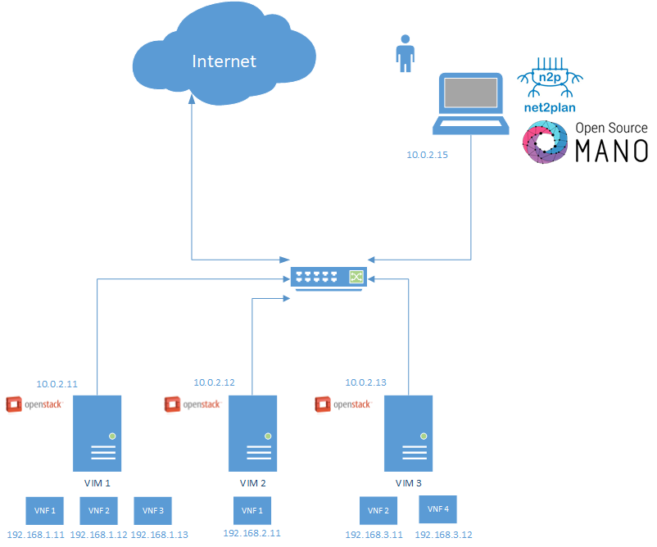
OFC 2018 Demo Schema
Joint Optimal Service Chaining allocation, VNF instantiation and Metro network resource allocation with OSM, Net2Plan and Netphony.
F.J. Moreno-Muro, C. San-Nicolas-Martinez, E. Martin-Seoane, M. Garrich, P. Pavon-Marino, O. Gonzalez de Dios, V. López
In a metro network with VIMs orchestrated by an ETSI-OSM instance, and an optical transport controller, we demonstrate optimized service chain provisioning using the open-source Net2Plan tool with interfaces to OSM (new) and transport controller
Achievements:
Net2Plan (N2P) is connected to OSM and OpenStack
Net2Plan provides optimal VNF placements, send the results to OSM which runs the network service instantiation
N2P is aware of the VIMs state (internal networks)
Interface N2P-OSM: RestAPI (OSMClient in Java)
Interface N2P-OpenStack: RestAPI (Openstack4J Library)

Slide 3
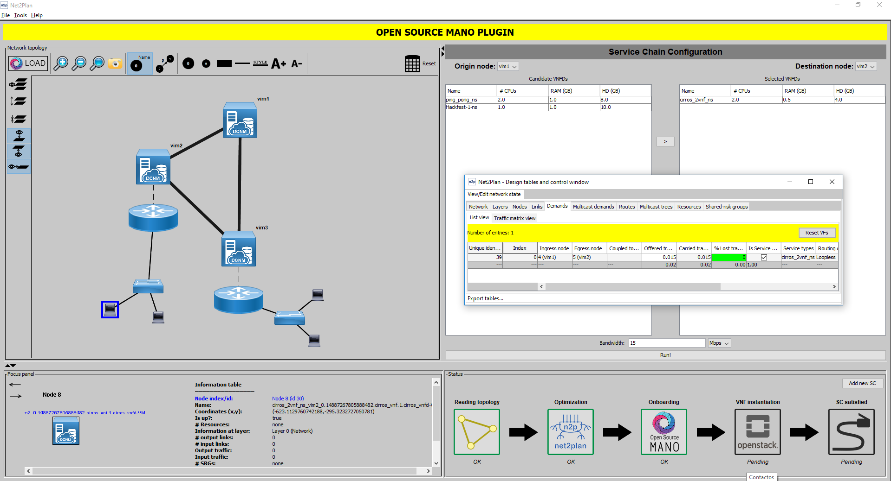
Graphic User Interface
Features:
Service chain defined by user
Overview of the network:
Nodes (VIMs)
Links (VIMs connected to a switch by ethernet)
Preview of the available NS with its flavors:
CPU
RAM
HD
Overview of the internal structure of the VIMs (OpenStack)
Workflow:
Read topology
Optimization
OSM Network Service
Instantiation of the VM in VIMs (OpenStack)
Connection Satisfied

